Slide 1
Conway & Taylor Meet the Strangler v2.0
6+ Techniques to Further Flow & DevOps in the Enterprise
Scott Prugh, Chief Architect & VP Software Development, scott.prugh@csgi.com, @ScottPrugh
Erica Morrison, Sr. Mgr. Software Development, erica.morrison@csgi.com
Notes:
1:00/1:00 A
My name is Scott Prugh and I support the NA development teams at CSG International. And this is Erica Morrison one of our developments leads that support our infrastructure teams. We are really excited to be back at DevOps enterprise.
Last year we presented a rear-view look at our improvements over the last few years. Today our presentation covers 6 techniques that build on our efforts from last year and provide a look at how we are continue to improve going forward.
We are hoping that practitioners and change agents in large enterprises are able to leverage our Lean and DevOps approaches to further their own change efforts.

Slide 2
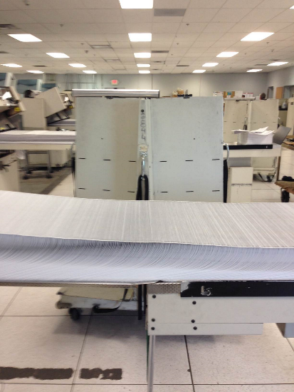



CSG in NA: Who Are We?
Customer Care and Billing Operations
~50M Subscribers across 120 customers
100k Call Center Seats
~6B External Transactions/month
40 Dev. Teams & 1000 Practitioners
ACP: ~20 Technology Stacks: JS to HLASM
Integrated Suite of 50+ applications
Challenges:
Time to Market & Quality/Release Impact
Technology Stovepipes
Role Stovepipes
Print and Mail Factory
~70M statements/month
Lean & Efficient
Challenges
Continuous Optimization
Notes:
1:00/2:00 A: need to go quickly
First, a quick overview of what we do at CSG. There are really 2 sides of our business in NA.
On the left we have our CC & billing operations. We are basically one of the first SaaS providers for a cable BSS/OSS stack in a box.
We support over 50M subscribers in the United States.
Our apps run on over 100K call center seats.
Our applications are developed by over 40 dev teams and supported by about 1000 people.
Our key suite(ACP) is delivered as an integrated set of 50+ applications that run across 20 technology stacks from JS to HLSAM on the mainframe.
We will be discussing our optimizations on this side of the business.
On the right we have our print and mail factory where we churn out 70m statements/month
For folks that have read the phoenix project, this is an eerie parallel to MRP-8

Slide 3
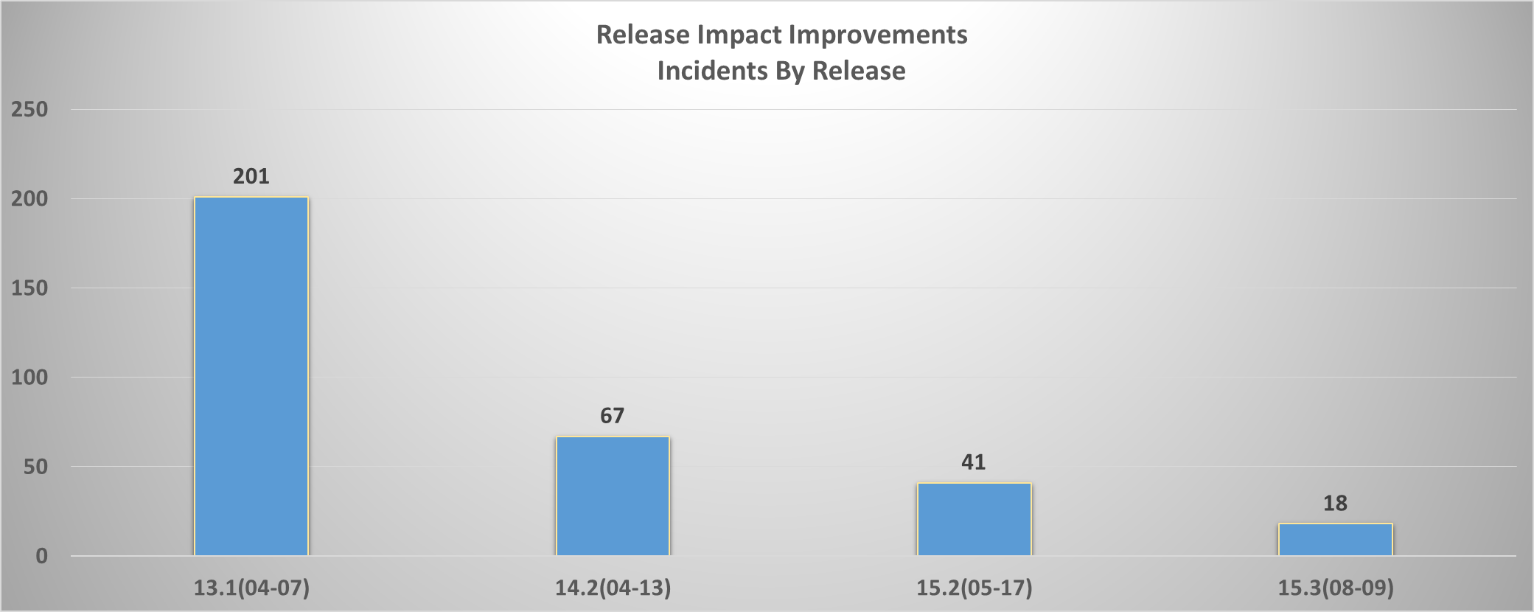
Quality Results: v1 Techniques
Last Year
Now
Reducing the batch size(28 to 14 weeks) and applying Lean & DevOps principles has resulted in a 90%(10x improvement).
And value is delivered in half the time!
Notes:
1:00/3:00 A
Last year I presented the results in the left two columns.
We started out in 2013 with production releases that were incurring 201 incidents. This was extremely painful for our customers and employees.
We implemented our first round of techniques and halved batch size which improved quality 66% and dropped our release incidents to 67
In the right columns are our continued improvements since. With continued practice and automation we have gotten even better.
Our most recent quarterly release yielded only 18 incidents.
This is 90% or a 10x improvement. For a legacy application suite across 20 technologies and 40 teams this is pretty amazing.
All of this was due to applying Lean Principles, DevOps and of course some good old Software Engineering.

Slide 4
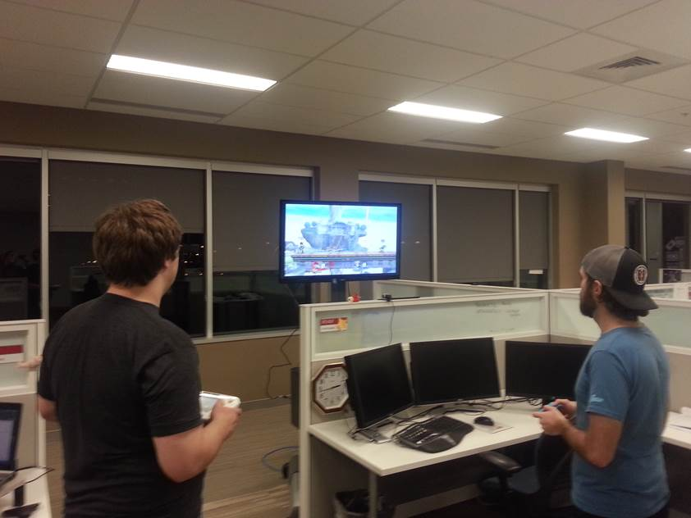
2015 Release Day 15.1(2/8/2015)
Operations Engineers watching over 15.1 deployment
71 features released to 50M subscribers

Slide 5


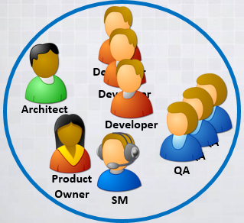
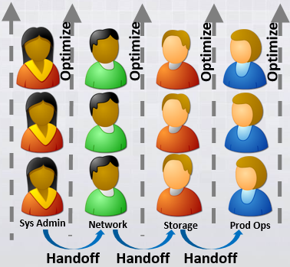


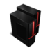
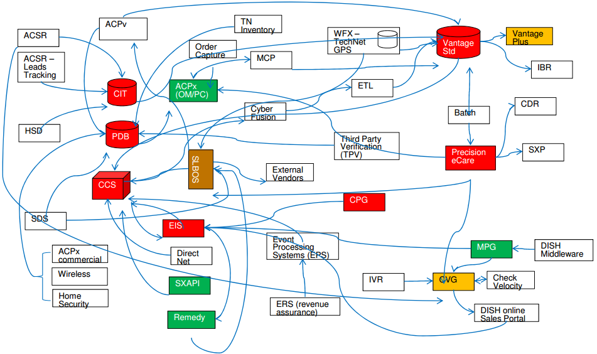
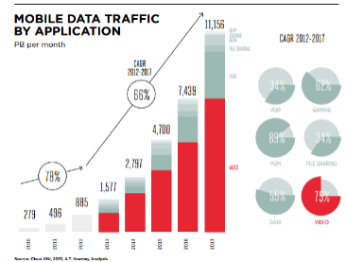

So, what’s the problem?
Demand for Quality & Speed
Organizational & Process Debt
API LAYER
Technical Debt
Middleware
Traditional SoR being stretched to become SoE
Customer expectations keep increasing
Sales Portal
Strive for Unimodal IT….
Notes:
1:30/4:30 A
So.. Great. 90% returns, near perfect releases. We keep getting better. So, what’s the problem. There are really 3:
1) Demand for Quality & Speed
We have a traditional set of systems that were designed as systems of record. There are exposed via APIs to our customers and their customers. The scale and integration of mobile and internet growth is pushing these SoRs to become SoEs Their scale and speed is being stretched. We continue to improve but, the expectations of our customers and their customers continue to increase just as fast of not faster.
2) Org Debt
The second problem is Org and Process Debt. Due to Taylorism and Conway we have many structures and processes that were built at a slower time and require handoffs to get work done. This creates failures, lag and prevents learning from occurring across the entire system.
3) Technical Debt
The final problem we see is the infamous technical debt issue. Like many companies we have a selection of components that have been built up over the years. Things like proprietary hardware, technical variance, lack of automated testing and lack of infrastructure automation continue to create failures and risk in the environment. We have green systems that can move quickly but systems in red act as speed bumps and inject risk as they undergo change. So, we strive for Unimodal Speed across all these assets by investing in automation and technical debt reduction as well as Culture and overall System Understanding.

Slide 6
Optimize for Quality & Speed
Pressures & Constraints
Demand for Quality & Speed
SoRs being pressured to become SoEs
Org & Process Debt
Technical Debt
Strive for Unimodal IT
Invest in:
Culture, Empathy, Understanding,
Simplicity & Automation
Techniques(v1)
Accelerate Learning & Lean Thinking
Inverse Taylor Maneuver
Inverse Conway Maneuver
Shared Service Continuous Delivery
Environment Congruency & Practice
Application Telemetry
Visualize Your Work
Work Release & WIP Limits
Cadence & Synchronization
Reduce Batch Size
Techniques(v2)
Holistically Improve Work Visibility
Incidents
Dependencies
Single Intake of Planned Work
Challenging Shared KPIs
Go See & Role Rotation
Infra as Code & Shared Understanding
Legacy Test Automation / ATDD
Telemetry & Shared Understanding
Notes:
1:00/6:30
Our overall goal is to Optimize for Quality & Speed. To battle these pressures and constraints we Strive for Unimodal IT and apply a set of v2 techniques that build upon our v1 techniques from last year. We’ll dive into those techniques right now.

Slide 7
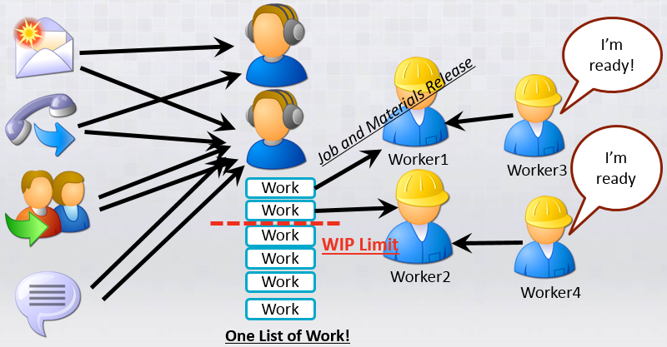
1. Holistically Improve Work Visibility
We have made significant strides in improving work visibility of features across development and operations.
To improve Quality and Speed we need to visualize and understand all work across:
Incidents
Dependencies
Single Intake and Tooling of all Planned Work: Features and Service Requests
Visualization of work will allow us to prioritize WIP and target areas of improvement.
Notes:
1:00/7:30
Our first technique is to Holistically Improve Work Visibility.
I talked last year about how we had done a lot of work to wrangle feature intake across development and operations. Although these steps have made great improvements and we finally feel that we are in touch with our WIP we are still see gaps in our visibility of work in several areas.
To continue to improve Quality and Speed we need to visualize and understand all work across: Incidents, Our Dependencies and finally better Intake management across not just features, but service requests.

Slide 8
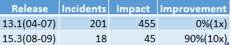

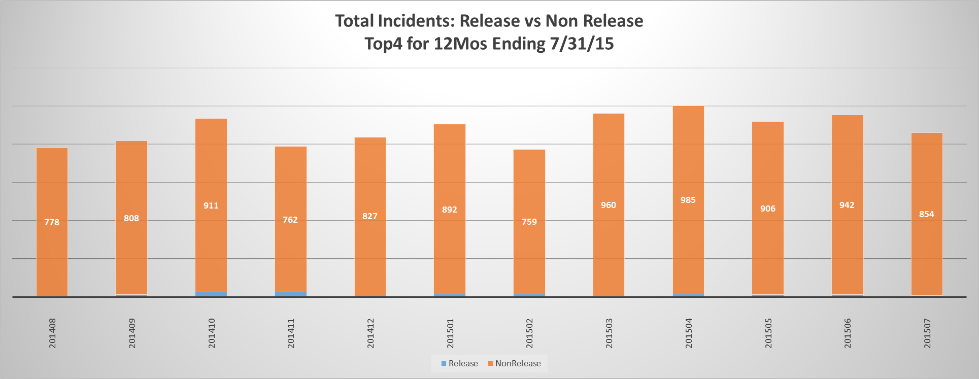
1a. Holistic Incident Visibility
Make incidents visible across all teams regardless of who is resolving them.
Notes:
1:30/9:00
Technique 1a is Holistic Incident Visibility
I just discussed how well we have done with reducing release impact. This was a pretty important step in improving client and employee satisfaction. Dropping 200+ incidents onto our clients in one day was not enjoyable.
At top in blue I have the current improvements I already discussed.
But, I have another picture for us to look at. If we zoom out, we can see that these releases only represented 1/5 of the impact and now only represent 1/50th of the total incidents being felt by our customers. This is one of those moments when you truly realizing you were not seeing the whole picture….

Slide 9
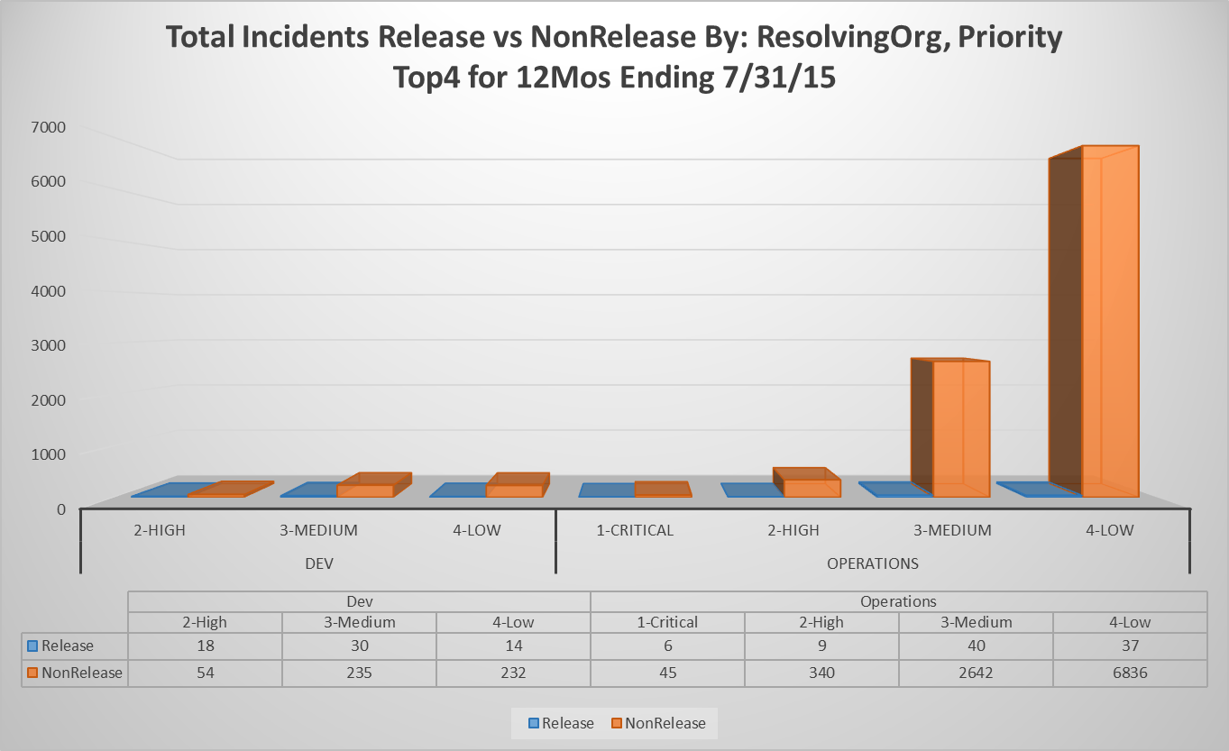
1a. Holistic Incident Visibility
Make incidents visible across all teams regardless of who is resolving them.
Key Findings:
Dev
Ops
3
Release incidents are <2% of volume
NonRelease incidents are > 98% of volume
Ops is burdened with repairing > 94% of volume
Med/Low is > 95% of volume
1
2
The Second Way:
Amplify Feedback Loops
KPIs?
Rotation? Telemetry?
Dev
Ops
Why isn’t this feedback happening?
Notes:
1:30/11:00
Here is another picture that should prove to be even more striking… On the left, we have development on the right we have ops. In blue are the incidents related to releases…. These are the ones we worked so hard to optimize away. In orange are incidents incurred off release as part of BAU activities or exist as latent issues.
A few statistics:
Incidents as part of a release represent <2% of total volume.
Operations is burdened with repairing 94% of the volume.
Additionally Med/Low is 95% of the volume.
Further analysis shows that 90% of this med/low volume is from less than 20 issues that originate from the same area.
By looking at this, it is clear that feedback is not happening. The Second way tells us to amplify feedback loops. Some ways we are looking to do that beyond incident visibility are through KPIs, Rotation and Telementry which Erica will discss.

Slide 10
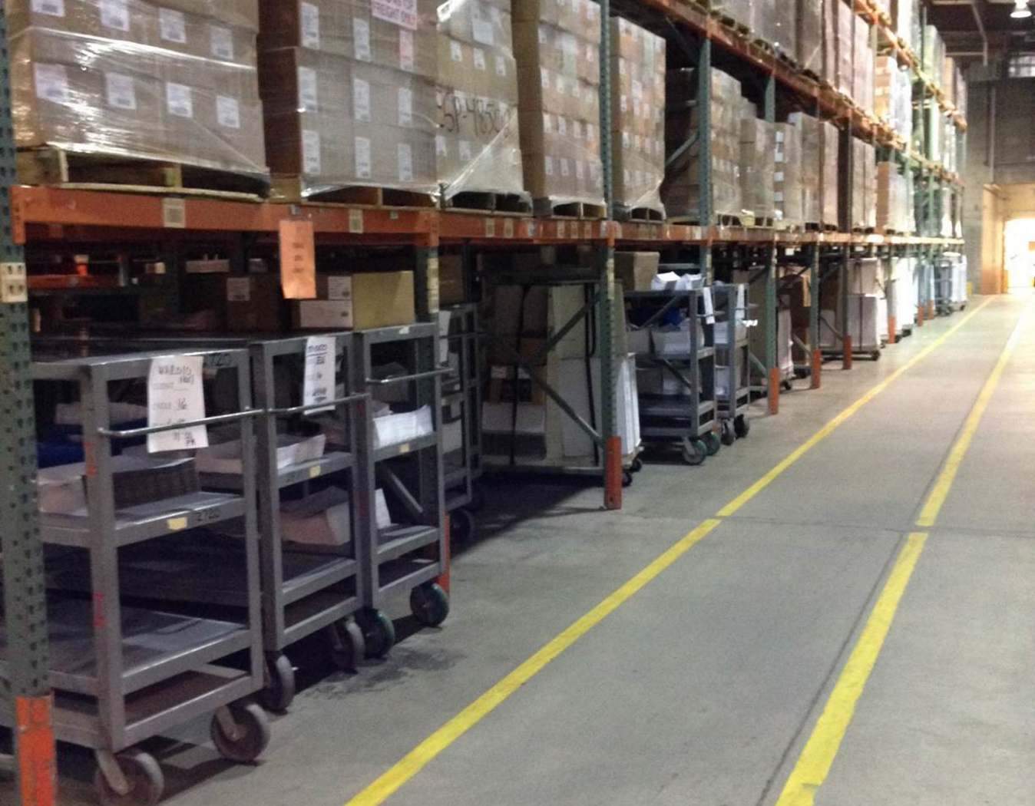
1b. Dependency Visibility
Treat virtualized work with the same care that manufacturing treats physical work.
Do you know how your work comes in and is scheduled?
Do you understand the dependencies required to satisfy the work?
Notes:
0:30/11:30
Technique 1b is Dependency Visibility
Another recap from last year. Here is a picture of our print factory. I’m standing in row1. Row1 contains carts that represent every job that is about to go into the system. On that cart are all is a job card that spells out all the materials and all the dependencies required to satisfy that job.
Last year I asked: Do you know how your work comes in and is scheduled?
This year I ask: Do you understand the dependencies required to satisfy the work?

Slide 11
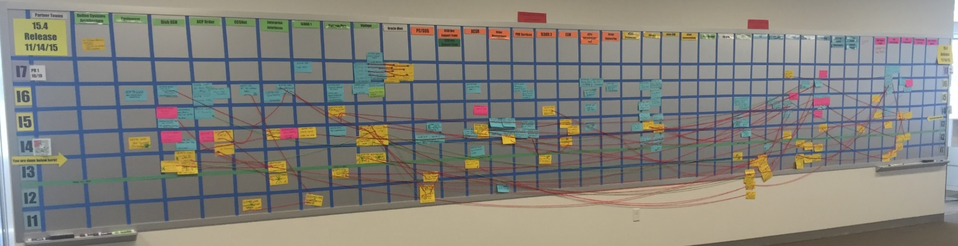

1b. Dependency Visibility
Make your team and system dependencies visible. Leverage this to increase understanding, unwind handoffs and move towards feature teams.
41 Teams
7 Iterations
“Conway’s Board”
http://www.scaledagileframework.com/release-planning
Notes:
1:00/12:30
This is Row1 for our software development program. This is a picture of our “program board”. On the vertical we have time: 7 iterations. On the horizontal you have the teams. There are 41.
The blue cards represent features. The yellow cards represent dependencies. The strings link the features to their dependencies.
This overall picture gives us a visual of our dependencies between component teams required to deliver a feature.
Conway predicted that 4 teams would create a 4 pass compiler. This to me looks like a 41 pass compiler.
By making our dependencies visible we can begin to understand handoffs and move towards feature teams.
One final note: This picture DOES NOT include all the operations teams required to deliver the solution.

Slide 12
1c. Single Intake of all Planned Work
Take the same care managing Features and Service Requests. Implement one intake stream in one tool. Provide visibility to all work and release it in a planned and coordinated way.
Toolset A
One Toolset
Toolset B
“One List”
SR List
Dev List
Ops List
One SR list that is not planned and requires undetermined capacity.
“One feature list” but separate prioritization and planning.
Problems with 3 lists and multiple tools:
Multiple tools create “Information Fog”
Dev. Features require dev and ops
Ops. Features can require dev
Service Requests can require dev and ops
Work and resource dependencies collide
Service Requests aren’t optimized/automated
One list planned and coordinated together.
Notes:
1:00/10:30
Technique 1c is Single Intake and Tooling of all Planned Work
By planned work I mean Features(creative enhancements) and Service Requests(BAU changes).
If you have multiple tools and multiple lists for planned work that cross the same resources then you need to fix that.
Multiple tools create an Information Fog that thwarts visibility and unnecessarily complicates coordination and release of work.
Additionally, even if you have one tool take care to coordinate release of work across features for different groups(Dev and Ops).
Dev features require dev and ops.
Ops features can require dev to make the changes(OS upgrades, security changes).
When you complicate this with the “Information Fog” from multiple tools your work and resource dependencies can easily collide and slow the entire system down.
One final thing: If your SR’s aren’t made visible and managed then they won’t be optimized engineered and streamlined.

Slide 13
2. Challenging Shared KPIs
Implement system-wide, shared KPIs that align all groups and all applications to deliver at one speed and high quality.
TTR for Critical/High needs to minimize impact to 2 hours.
Reduce volume by 50%.
Type | Area | Class | Ops (Goal) | Dev (Goal) | Ops (Actual) | Dev (Actual) | DevOps (Goal)
Incident | TTR | Critical | 2h | 12h | 2.07h | 0h | 2h
Incident | TTR | High | 4h | 15d | 4.43h | 2.13d | 2h
Incident | TTR | Medium | 3d | 90d | 1.45d | 19.87d | 3d
Incident | TTR | Low | 5d | 90d | 1.09d | 24.69d | 5d
Incident | Volume(Release) | Critical |  | 0 | 6 | 0 | 0
Incident | Volume(NonRelease) | Critical |  |  | 45 | 0 | 23
Incident | Volume(NonRelease) | High |  |  | 340 | 54 | 197
Incident | Volume(Total) | Total |  |  | 9,955 | 583 | 1,054
Feature | Feature Lead Time |  |  |  |  | 135d | 65d
Med/Low needs to incent code fixes not just workarounds. Faster dev response plus reducing volume by 90%.
Measures as a feedback mechanism.
Notes:
1:30/14:00
10/12: Tighten up message and verbiage around C/H. Tie to focus areas 1,2,3
Our second technique is Challenging Shared KPIs: Implement system-wide shared KPIs that align all groups.
As we previously saw with Incidents: Feedback in the system is not occurring. More specifically, we see groups(dev & ops) that have different KPIs around incident SLAs
This incents non System Thinking behavior where one group optimizes differently than the other.
As mentioned in our focus areas we are looking at shared KPIs across first Critical/High and then Med/Low.
First, with C/H: Note that today Ops response for High is 4h but for dev it is 15d. This incents quick fixes and workarounds and not overall system improvements. Additionally, our clients are continually looking for greatly reduced resolution times for High issues so we are pushing that shared goal to 2 hours.

Slide 14



3. Go See & Role Rotation
Leverage role rotation to build understanding and empathy across teams.
“It helped with my overall
knowledge of all of what CSG does”
“It gives me some background on department workings to help with Lean Initiatives”
“It helps me to be able to troubleshoot Kiosk issues better”
“I got to see (change management tools) being used and how the changes are put in. Great overall understanding of the process”
Dev
Ops
ISC
Notes:
~1 min
The Go See program provides our people with the opportunity to get to experience a day in the life of other teams
Participants sit with the other department(s) that they select and spend several hours learning about exactly what that other teams’ job entails.
By taking part, people get a better understanding of the work and challenges other teams face, growing empathy and partnerships
Traditionally, organizations have been silo’d in their thinking and perspectives.
As anyone from a large organization can attest to, there is virtually no way the system as a whole can be understood and no one can hope to understand more than a small part of it
People optimize for what is visible to them and the feedback they get, which is more or less determined by the people they interact with on a day-to-day basis
Having Dev and Ops participate provides cross-pollination across teams and allows our teams to develop more whole-system thinking. That way, we can attack continuous improvement for the entire value stream rather than optimizing a particular function at the sacrifice of downstream or upstream processes.
~40 seconds
The Go See program itself is very lightweight, with little time required to request participation. There’s a home page that covers an overview and details of each Go See session, as well as the ability to apply for participation in about a minute.
An outline is provided for each Go See. Each session can run the gamut from primarily hearing about the different aspects of the job to digging in and doing the job right alongside the person
<TBD after I complete the Go See>
While this program is something that has been in place for awhile, with 23 organizations current participating, we are very excited to extend this to Dev and continue to grow the empathy between the orgs. We also are looking at rolling out an additional 2 week rotational component to this program on top of the existing, lightweight, 2-8 hour program
On the right side of this slide, you see a few examples of feedback we’ve gotten from the program. I won’t read these to you, but we have seen people feel they have a better understanding of different processes and orgs, and as a result, they can do

Slide 15




4. Infra as Code & Shared Understanding
Leverage infrastructure as code with to build expertise and understanding across the value stream.
Master
VM
14 Windows Agents
2 Linux Agents
2 Solaris Agents
Pilot project : Jenkins infrastructure
Notes:
~1 min
We’ve spent substantial effort recently to move CSG towards continuous delivery and infrastructure as code
We chose to pilot this with the team that manages our build infrastructure
This was a good candidate as this team provisions 15 new windows VMs 4x/year for the Jenkins master and agents. They also ensure they have everything on them needed to build all of our components.
Additionally, the team in charge of this environment is already a true DevOps team employing the concept of you build it, you run it – owning the end-to-end lifecycle of the Jenkins environment
We are now able to provision our Jenkins farm with the click of a button.
Actually leverage Jenkins itself to kick off this process, create our VMs in vSphere and then run our cookbooks.
Can leverage the work we have done to begin rolling this out to other parts of our enterprise
Martin Fowler talks about how “A server should be like a phoenix, regularly rising out of the ashes”
In contrast, snowflake servers are long running servers that have evolved from their first configured state. They can become unique, and difficult to reproduce.
We want to move towards Phoenix not flakes
Now that we have our pilot project in place, we are well positioned to begin doing this

Slide 16
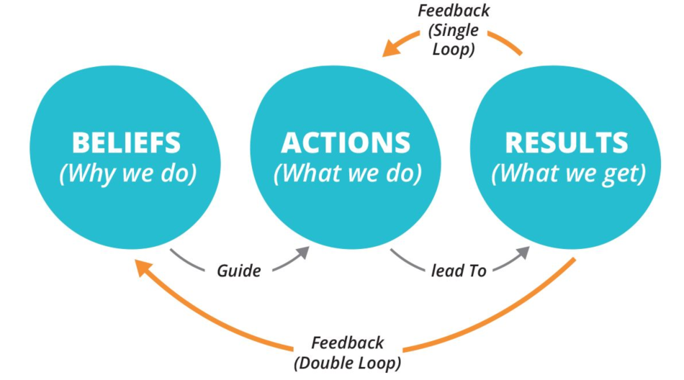


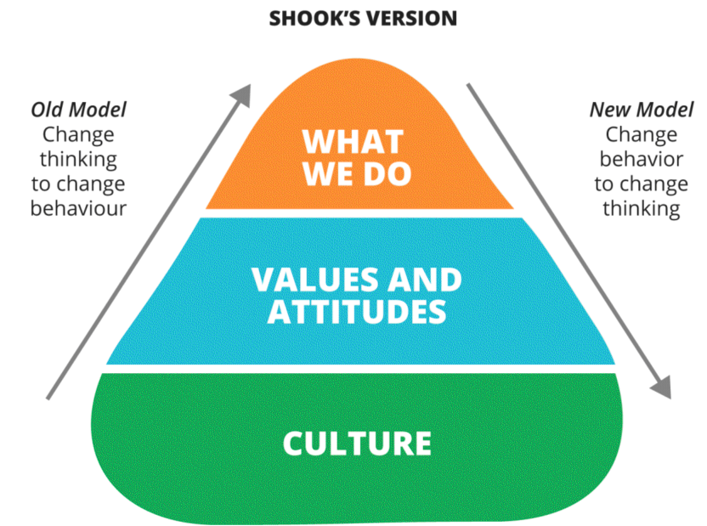


Behavior Changes & Double Loop Learning
Use shared, collaborative initiatives to “Challenge the Status Quo”, change company norms and change what people do.
Architect
Developer
QA
Product Owner
SM
Lean Enterprise: Jez Humble, Joanne Molesky, Barry O’Reilly
Prod Ops
Platform
True Cross Functional Team
Notes:
> 3 min
While what we’ve accomplished with Chef is very important, I also want to talk about how we accomplished it
We knew the Chef initiative was truly an enterprise initiative and it quickly became apparent that we would need a new way of doing business to accomplish this. We challenged the status quo in a number of ways
Chef journey initially faced many roadblocks as we set out to make enterprise impacting changes that crossed many orgs
Ran into process impediments such as the paperwork traditionally required to request a VM and budgetary concerns
Ran into resistance to embracing a particular technology as multiple groups had begun experimenting with infrastructure as code and already had their preferred technology
To combat this, we got senior leadership buy-in across multiple Dev and Ops organizations to allow ESM to be pilot team
Committed to a technology (chef)
Committed to removing impediments
Committed resources and prioritization
Not just resources, but the right resources
Senior leaders gave people the permission and set the expectation that the current process should be challenged
Management theorist Chis Argyris coined the phrase double loop learning. This occurs when and error is corrected in ways that involve the modification of an organization’s underlying norms, policies and objectives. This is more than changing what we do, but also challenging our belief system
We did this in multiple ways
We changed the idea of how a team could be structured, pulling in from multiple orgs to create a true cross-functional feature team to solve a shared problem and build a new understanding
“Core” team of dedicated dev personnel
Supplemented by members of Ops teams including platform architecture, and deployment (BL) team
Created joint standup and planning
Quick visibility into issues and priorities allows for quick removal of roadblocks
Insight and shared information from Ops team members promotes learning and speed
Daily interaction promotes empathy and shared understanding
We also challenge people to think of these problems(process and technology) as System Problems that needs Front End Thinking.
Historically, we’ve often solved problems by continually duct taping something onto the finished system (for example patching). Instead, we want to design from the front of the factory to reduce variability and reduce NVA.
Through a new approach to a problem (cross-functional team, infrastructure as code), we have changed behavior and have thus changed the thinking and mindset of team members.
Accomplishing culture change in this manner is what’s recommended by John Shook based on his work at Toyota and New United Motor Manufacturing Inc.
Traditional models attempted to change the thinking to change the behavior. We’ve inverted that
Expected continued change in beliefs and culture over time

Slide 17
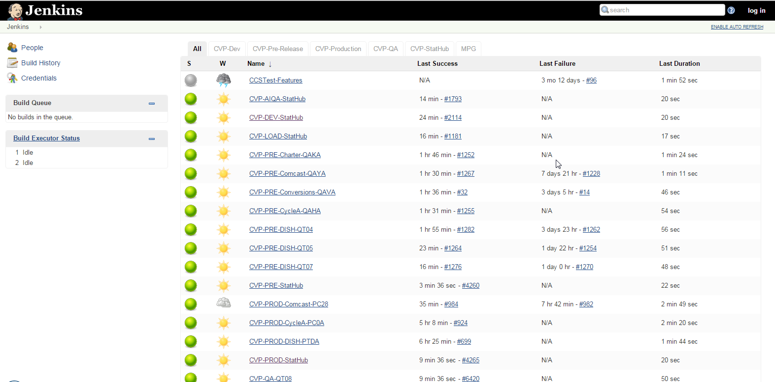
5. Legacy Test Automation / ATDD
Leverage ATDD and automation to evolve legacy systems, improve velocity and quality while reducing the risk of change. Embrace “Unimodal Speed” and strangle off complexity.
Legacy
System
XML
SpecFlow
Tests
Modern
System
XML
ATDD
Continuous Validation Portal
Notes:
~2 min
CSG has been applying automated test concepts throughout the organization. This effort is really starting to gain traction.
One success story in particular that I’d like to talk about is SLBOS and their porting of legacy code to a modern system. They’ve accomplished this using ATDD practices and a Continuous Validation portal.
SLBOS processes more than a billion transactions a month for over 50 million customers of key cable and satellite companies.
SLBOS used a complex and arcane middleware to build the nearly 300 transactions exposed to clients.
The complexity of the code, combined with lack of tests, prevented them from changing the system in a rapid and low-risk way.
Given this, the teams decided to apply the Strangler Pattern to greatly simplify the operating environment and the application code.
As part of applying the strangler pattern, the development team began gaining API test coverage across the legacy system for one area at a time.
SLBOS uses SpecFlow to define their system tests.
Once coverage had reached a satisfactory level, the transaction could be ported with near zero risk.
You can see in the diagram here that we run the exact same specflow tests against our legacy system as our modern .NET system and compare the resulting XML to confirm we are getting the expected results.
Our customers have coded to the specific XML messages being provided by our legacy system, so it’s key to ensure our output is EXACTLY the same. Our Specflow tests will fail if the results are not exact, allowing us to uncover any issues or missing business logic immediately, without impact to clients
We’ve extended upon our ATDD foundation and are leveraging our robust Jenkins infrastructure to now validate all of our different environments as well.
It runs SLBOS transactions against major subsystems for all major customers across all environments multiple times a day
Allows us to quickly assess the status of all components across our different environments to give us high confidence that the system is performing as expected

Slide 18
5. Legacy Test Automation / ATDD
Leverage test automation and ATDD with legacy code to reduce re-work and increase feature development time.
Activity | Before Time | After Time
Agile Planning | 5.00% | 5.00%
Environment Setup | 10.00% | 5.00%
Code Builds | 10.00% | 0.00%
Production/Downstream Support | 25.00% | 10.00%
Testing – Current Features | 15.00% (Manual) | 20.00% (Automated)
Testing – Regression | 20.00% | 5.00%
Feature Development | 15.00% | 55.00%
Notes:
~ 1 min
I’ve talked a lot about what we’ve changed as far as our automated testing in the SLBOS use case.
We have metrics shown here showing benefits we’re getting from adding this automation.
Testing wasn’t the only aspect of the improvement, we improved other areas as well. However, testing was a large portion of this improvement.
As you can see, we are able to dedicate substantially more time to feature development.
Our quality and speed have both increased across dev and ops
Our risk has been reduced.
Overall, testing makes the environment well understood and safe to change
Our current development cadence includes two hardening iterations each release. CSG will be removing a hardening iteration in 2017 and this is a great use case to model for other teams as we look to reduce the amount of QA and defect-fixing time across the company. I’ve actually shared this use case with my teams to help solidify the understanding of the value of automated tested as well.

Slide 19
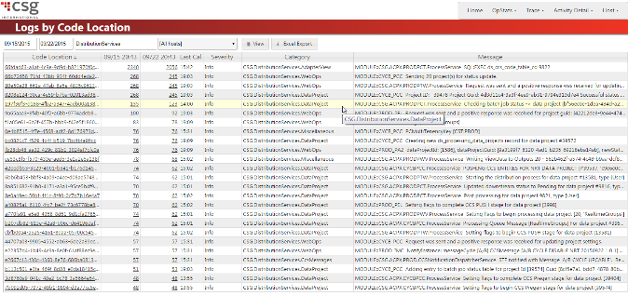

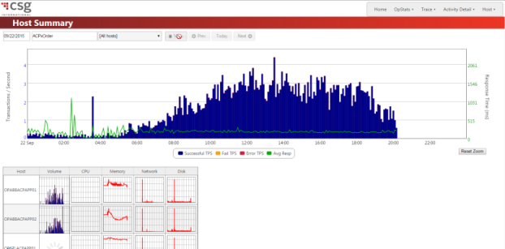

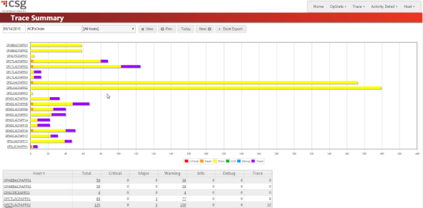
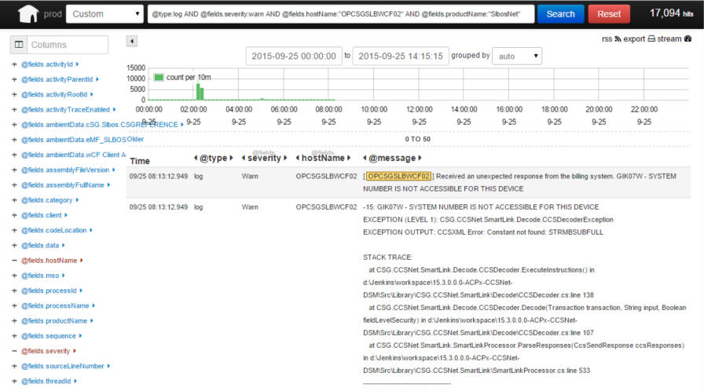
6. Telemetry & Shared Understanding
Leverage telemetry as a learning platform to increase cross-team understanding of system behavior. Evolve your telemetry to accelerate feedback..
Dev
REST/AMQP
Ops
ISC
Sales Support
Notes:
~2:15
Continue to invest in and improve the telemetry for our systems to better understand overall system behavior
Currently we build and embed telemetry into all pieces of our application. Our code sends trace and activity information in real time to an app we call SH.
Process over 175 million records per day, peaking at around 4000/sec
As you can see in the diagram, we have all of our servers sending data to a central location (ES).
Reports then provide nice views of the data for analysis. These same reports are accessible by members of different orgs including dev, ops, our help desk, and our business units. Having this shared common view creates a platform for shared understanding between development and operations in particular
We recently had a meeting of key senior leaders from both development and operations and a recurring theme that came up multiple times was the value of having central telemetry, covering all aspects of a system, available in one place
So, this system that didn’t even exist a few years ago clearly proven it’s value across orgs
I’d like to share some of the improvements we are making to this telemetry system.
Additional applications
Core SH logging and tracing libraries were originally written in .NET. We are now extending this to be able to process data from other technologies by doing things like providing Java libraries
Incorporating legacy systems. For example, one product we have is a thick client that runs on X hundred thousand desktops. Historically, logs from this system were saved locally to each desktop. If there was an error, the CSR called our helpdesk, and then logs manually were sent to CSG for troubleshooting
This application has now been changed to instead use our logging infrastructure to send gzipped files to a REST endpoint for incorporation into StatHub.
We can now see logging and activity information for this legacy app in StatHub. This will allow us to decrease MTTR and also drive improvements
Migrating additional capabilities from a legacy telemetry application into SH to provide host statistics and alerting

Slide 20
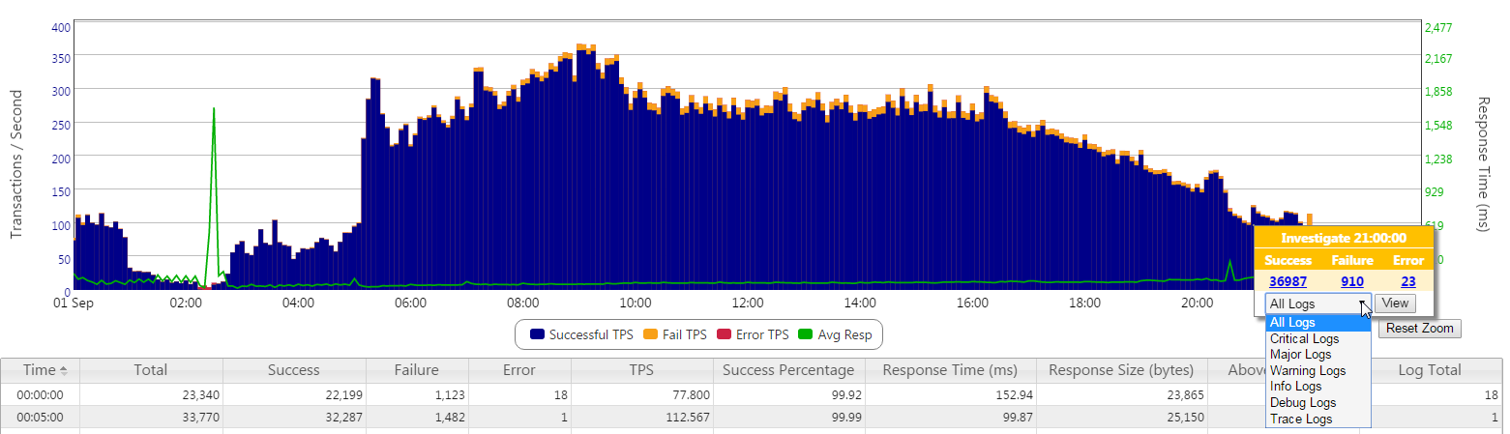
6. Telemetry & Shared Understanding
Collaborate and rapidly evolve telemetry to improve system understanding.
See this blip?
Kibana Query
@type:log AND @fields.severity:warn AND @fields.productName:"SlbosNet" AND (@fields.hostName:"OPDSHSLBWCF02" OR @fields.hostName:"OPDSHSLBWCF03" OR @fields.hostName:"OPDSHSLBWCF04" OR @fields.hostName:"OPDSHSLBWCF05" OR @fields.hostName:"OPDSHSLBWCF06" OR @fields.hostName:"OPDSHSLBWCF07" OR @fields.hostName:"OPDSHSLBWCF08" OR @fields.hostName:"OPDSHSLBWCF09" OR @fields.hostName:"OPDSHSLBWCF10")
Notes:
~ 30 seconds
I mentioned that StatHub provides a good platform to develop shared understanding of overall system behavior between dev and ops
One such example is a troubleshooting session with Scott and a member of the Ops team working together on the issue seen here (the blip)
Through this collaboration, they identified a proposed telemetry change to get to root cause faster. Basically, the ask was to be able to better drill into associated log detail records behind this summary data
Ops sent this request telemetry team September. We were able to turn around the change and deploy it to production within a few weeks.

Slide 21
Summary
Techniques(v1)
Accelerate Learning & Lean Thinking
Inverse Taylor Maneuver
Inverse Conway Maneuver
Shared Service Continuous Delivery
Environment Congruency & Practice
Application Telemetry
Visualize Your Work
Work Release & WIP Limits
Cadence & Synchronization
Reduce Batch Size
Techniques(v2)
Holistically Improve Work Visibility
Incidents
Dependencies
Single Intake of Planned Work
Challenging Shared KPIs
Go See & Role Rotation
Infra as Code & Shared Understanding
Legacy Test Automation / ATDD
Telemetry & Shared Understanding
Questions/Help:
How are large enterprises rapidly evolving towards PaaS and away from task based infrastructure?

Slide 22
Credits
Lean Enterprise: How High Performance Organizations Innovate at Scale; Jez Humble, Joanne Molesky, Barry O’Reilly
Leading the Transformation: Applying Agile and DevOps Principles at Scale; Gary Gruver and Tommy Mouser
Agile IT Organization Design: For Digital Transformation and Continuous Delivery; Sriram Narayan
Avoiding the Alignment Trap in IT: http://sloanreview.mit.edu/article/avoiding-the-alignment-trap-in-it
The Phoenix Project, Gene Kim, Kevin Behr, George Spofford
Continuous Delivery, Jez Humble
Scaled Agile Framework: www.scaledagileframework.com

